Slide 1


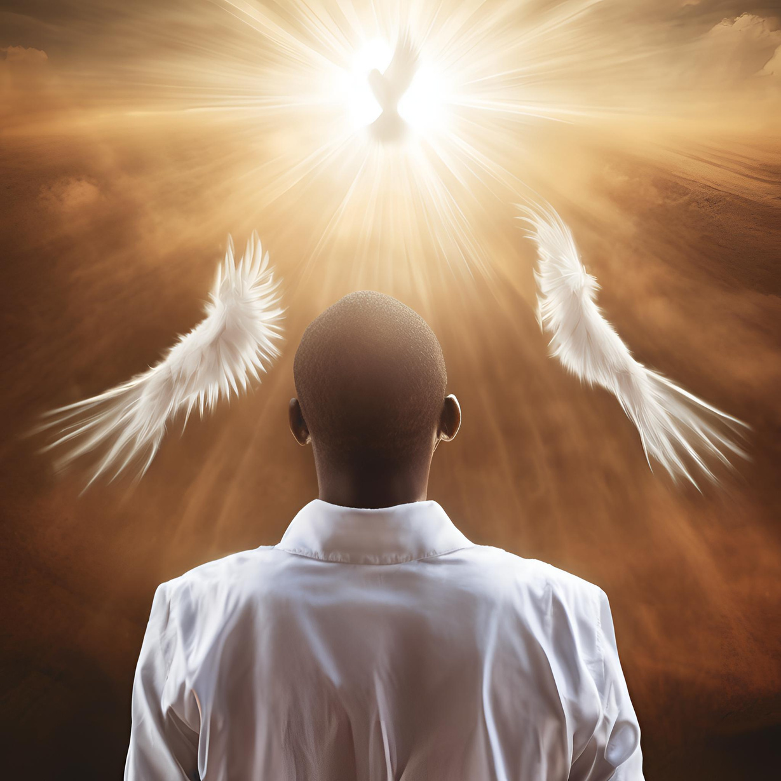


WELCOME TO
2025

Slide 2


T3WM:
DEFINED BY ....
2025
Global Outreach
Missions

Slide 3



Global Outreach
Missions
LESSON 1
LESSON 5
01
05
Defined by all God’s Promises
Healing Belongs to You! Divine Health Defines You in Christ!
LESSON 2
LESSON 6
02
06
TABLE OF
CONTENT
As Jesus is, so Am I in this World
Abundant Provision is your inheritance in Jesus. You lack nothing in Him!
LESSON 3
03
God’s Promises to the Righteous Defines Who You Are in Christ!
LESSON 7
07
Rest in What God Says about Your Children & Grandchildren
LESSON 4
04
The Prayers of the Righteous are Powerful & Effective

Slide 4


Lesson 1
Defined by all God’s Promises
Global Outreach
Missions

Slide 5




Global Outreach
Missions
Defined by all God’s Promises
Key Theme:
Your true identity is defined not by the world, opinions, or circumstances, but by every promise and word spoken by God over you in Christ. This presentation explores the truth of who you are according to God's Word.
Introduction: Identity Defined by God's Promises
Foundational song:
Theme song for these lessons: 'I know Who I Am by Sinach, emphasizing our divinely defined identity in Christ'
Jesus' Prayer in John 17:13-17 (MSG):
Jesus speaks words of life, prays for protection from evil, and declares that believers are no longer defined by the world but by God's truth—His Word. This consecrating truth sets you apart and fills you with His overflowing joy.
I am Defined by Every Word God Says
Authority of God's Word:
God's promises override worldly definitions or opinions. Your true self is found in the identity God speaks over you. Responding to God's promises is key to experiencing this reality.
4 | Page

Slide 6
Global Outreach
Missions
John 17:13-17 (MSG)
¹³ Now I’m returning to you. I’m saying these things in the world’s hearing so my people can experience My joy completed in them.
¹⁴ I gave them your word; The godless world hated them because of it, because they didn’t join the world’s ways, just as I didn’t join the world’s ways.
¹⁵ I’m not asking that you take them out of the world, but that you guard them from the Evil One.
¹⁶ They are no more defined by the world Than I am defined by the world.
¹⁷ Make them holy—consecrated—with the truth; Your word is consecrating truth.
Introduction: Identity Defined by God's Promises
I am Defined by Every Word God Says
4 | Page

Slide 7
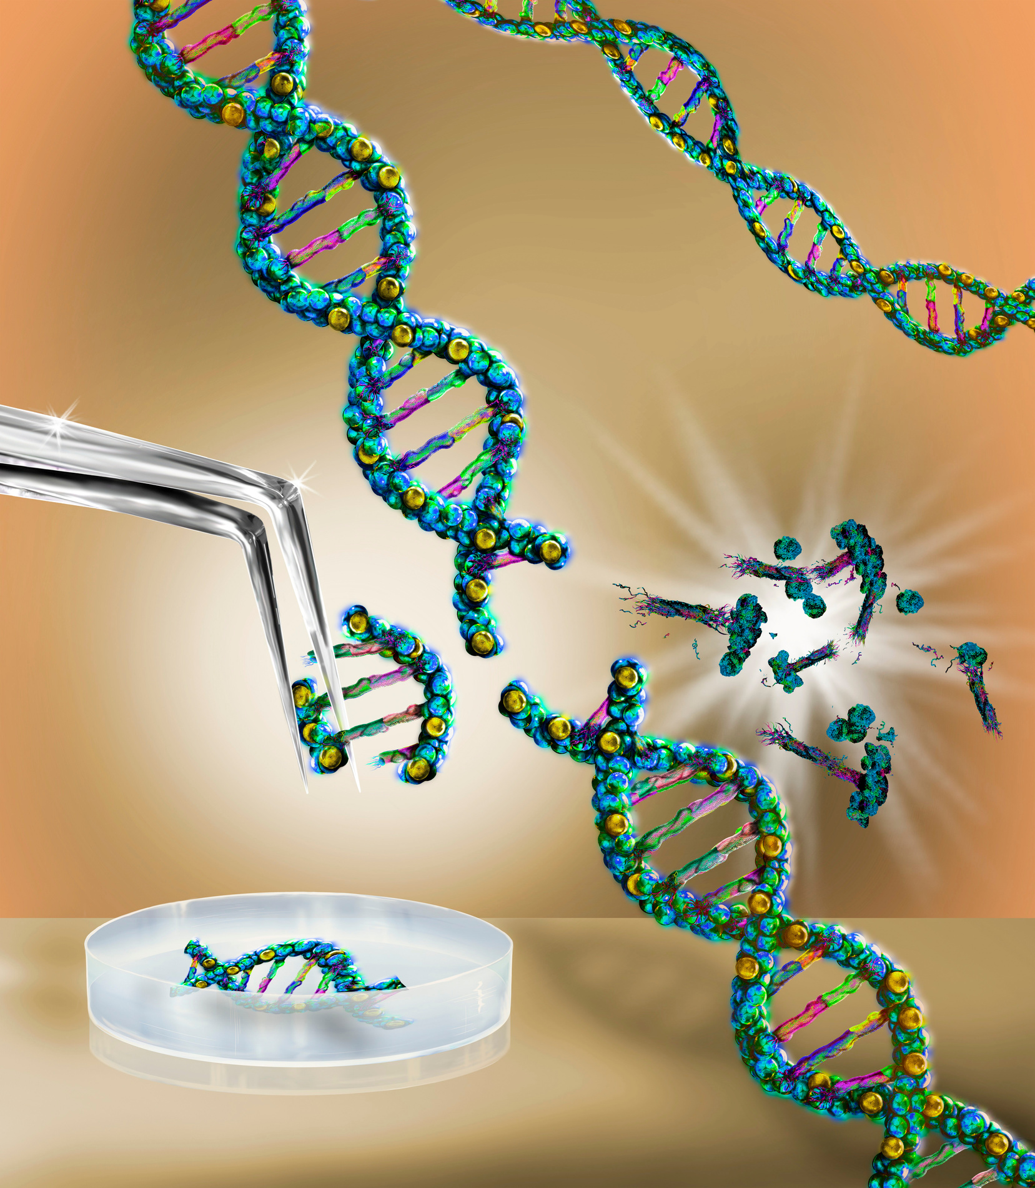


Global Outreach
Missions
Defined by all God’s Promises
God's Promises: Priority Over Genetics
Romans 9:6-9(MSG); John 1:12-13(NIV)
Your identity in Christ is determined by God's promise, not your natural lineage or genetics. God gives all who believe the right to become His children, born of God, with Divine Nature Always (DNA).
Application
Your new identity is divinely defined by God's promises. You possess a new spiritual lineage- Heavenly Father's DNA.
5 | Page

Slide 8
Global Outreach
Missions
Defined by all God’s Promises
Romans 9:6-9(MSG)
⁶ Don’t suppose for a moment, though, that God’s Word has malfunctioned in some way or other. The problem goes back a long way. From the outset, not all Israelites of the flesh were Israelites of the spirit. It wasn’t Abraham’s sperm that gave identity here, but God’s promise. Remember how it was put: “Your family will be defined by Isaac”? That means that Israelite identity was never racially determined by sexual transmission, but it was God-determined by promise. Remember that promise, “When I come back next year at this time, Sarah will have a son”?
5 | Page

Slide 9
Global Outreach
Missions
Defined by all God’s Promises
John 1:12-13(NIV)
¹² Yet to all who did receive him, to those who believed in his name, he gave the right to become children of God— ¹³ children born not of natural descent, nor of human decision or a husband’s will, but born of God.
5 | Page

Slide 10
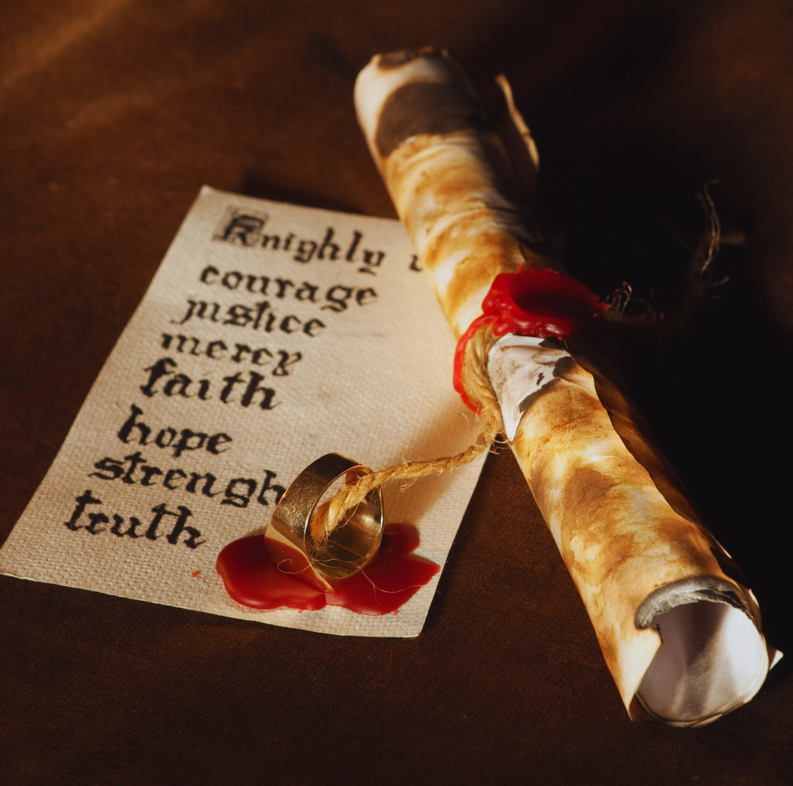
Global Outreach
Missions
Defined by all God’s Promises
Partaking of God's Divine Nature
2 Peter 1:3-11 (TPT) - The Power of Promises
God has given everything needed for life and godliness through His divine power and precious promises. These enable you to share in His divine nature, escaping the corruption of the world's desires.
Virtues Within You
Faith, goodness, understanding, self-control, endurance, godliness, mercy, and unending love are planted deep within, defining your divine identity.
6 | Page

Slide 11
Global Outreach
Missions
Defined by all God’s Promises
2 Peter 1:3 (TPT); 4-5 (NLT); 6-11(TPT)
³ Everything we could ever need for life and godliness has already been deposited in us by His divine power. For all this was lavished upon us through the rich experience of knowing Him who has called us by name and invited us to come to Him through a glorious manifestation of His goodness. (TPT)
⁴ And because of His glory and excellence, He has given us great and precious promises. These are the promises that enable you to share His divine nature and escape the world’s corruption caused by human desires. ⁵ In view of all this, make every effort to respond to God’s promises. Supplement your faith with a generous provision of moral excellence, and moral excellence with knowledge, (NLT)
6 | Page

Slide 12
Global Outreach
Missions
Defined by all God’s Promises
2 Peter 1:3 (TPT); 4-5 (NLT); 6-11(TPT)
⁴ by which have been given to us exceedingly great and precious promises, that through these you may be partakers of the divine nature, having escaped the corruption that is in the world through lust. ⁵ But also for this very reason, giving all diligence, add to your faith virtue, to virtue knowledge, (NLT)
⁵ So devote yourselves to lavishly supplementing your faith with goodness, and to goodness add understanding, ⁶ and to understanding add the strength of self-control, and to self-control add patient endurance, and to patient endurance add godliness, (TPT)
6 | Page

Slide 13
Global Outreach
Missions
Defined by all God’s Promises
⁷ and to godliness add mercy toward your brothers and sisters, ⁸ Since these virtues are already planted deep within, and you possess them in abundant supply, they will keep you from being inactive or fruitless in your pursuit of knowing Jesus Christ more intimately. ⁹ But if anyone lacks these things, he is blind, constantly closing his eyes to the mysteries of our faith and forgetting his innocence—for his past sins have been washed away. ¹⁰ For this reason, beloved ones, be eager to confirm and validate that God has invited you to salvation and claimed you as his own. If you do these things, you will never stumble ¹¹ As a result, the kingdom’s gates will open wide to you as God choreographs your triumphant entrance into the eternal kingdom of our Lord and Savior, Jesus the Messiah. (TPT)
6 | Page

Slide 14
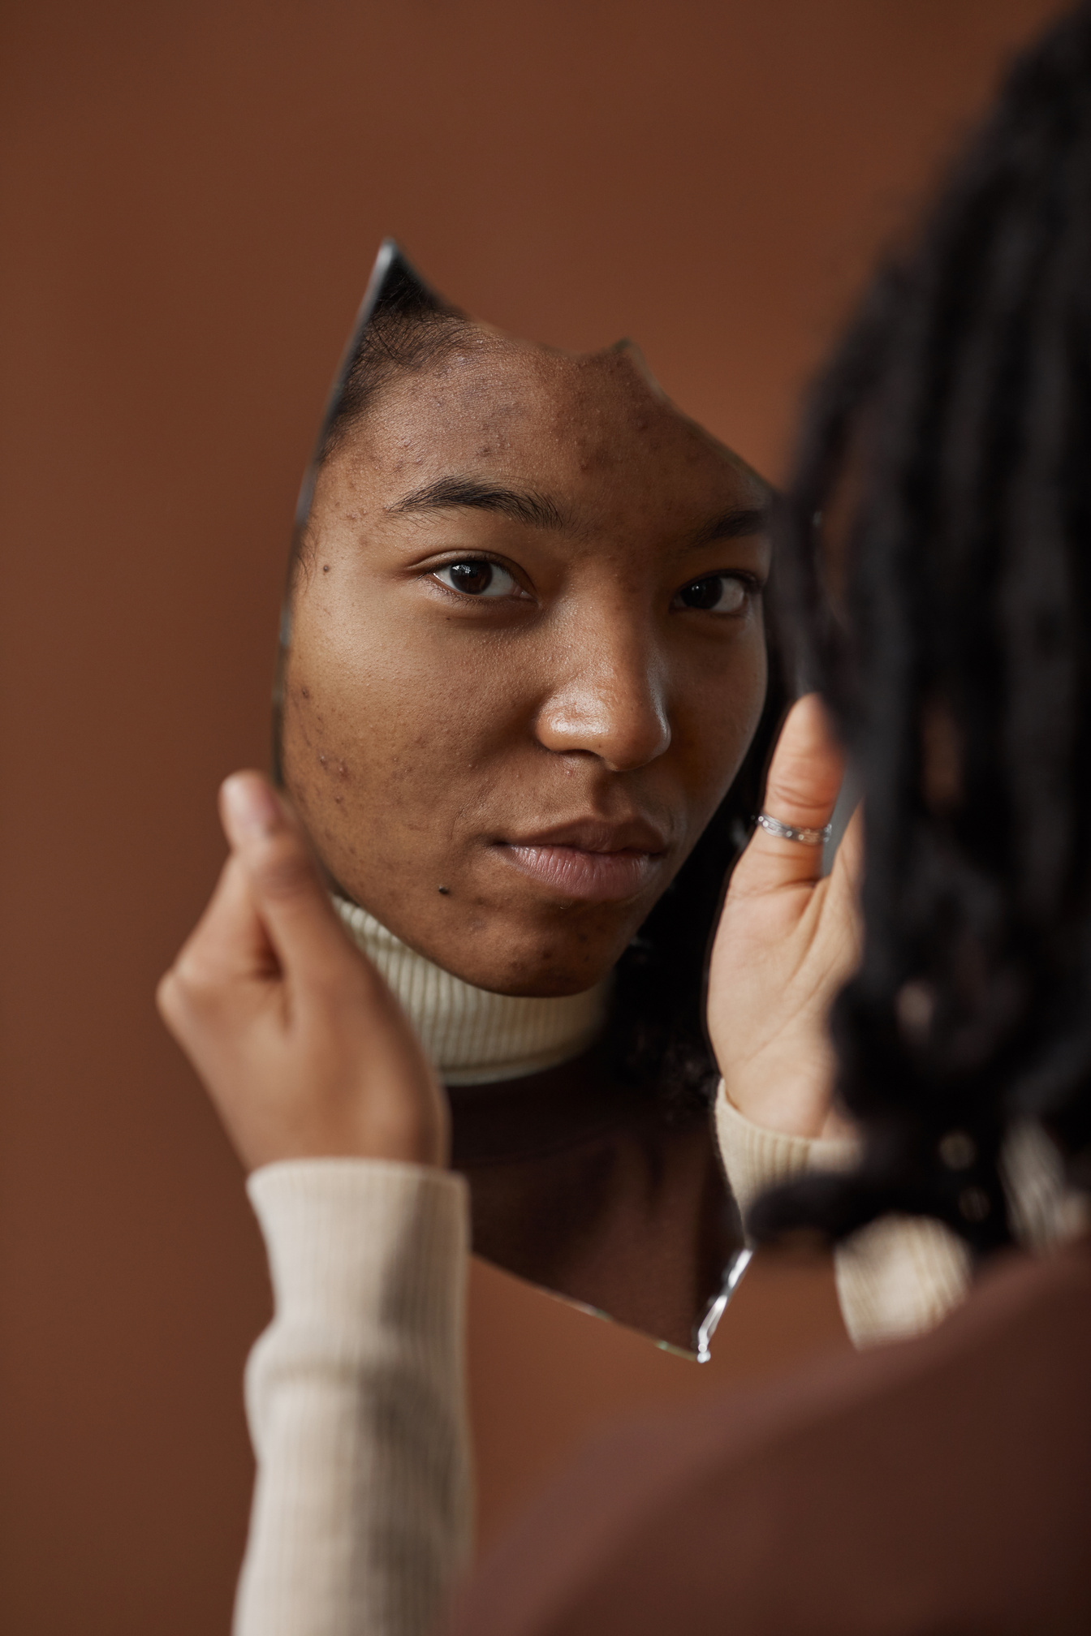


Global Outreach
Missions
Defined by all God’s Promises
Responding to the Word: Mirror Principle
James 1:21-25 (TPT) - Mirror of the Word
God's Word, implanted in your nature, has the power to continuously bring deliverance and peace. Listening without responding is self-deception; responding turns the truth into your living reality.
Spoken Response
Speaking what God says about you - 'I am defined by all God's promises' - activates the power of His Word in your life.
7 | Page

Slide 15
Global Outreach
Missions
Defined by all God’s Promises
James 1:21-25 (TPT)
²¹ So this is why we abandon everything morally impure and all forms of wicked conduct. Instead, with a sensitive spirit we absorb God’s Word, which has been implanted within our nature, for the Word of Life has power to continually deliver us. ²² Don’t just listen to the Word of Truth and not respond to it, for that is the essence of self-deception. So always let his Word become like poetry written and fulfilled by your life! ²³ If you listen to the Word and don’t live out the message you hear, you become like the person who looks in the mirror of the Word to discover the reflection of his face in the beginning.
7 | Page

Slide 16
Global Outreach
Missions
Defined by all God’s Promises
James 1:24-25 (TPT)
²⁴ You perceive how God sees you in the mirror of the Word, but then you go out and forget your divine origin. ²⁵ But those who set their gaze deeply into the perfecting law of liberty are fascinated by and respond to the truth they hear and are strengthened by it—they experience God’s blessing in all that they do!
7 | Page

Slide 17

Lesson 2
As Jesus is,
so Am I in this World
Global Outreach
Missions

Slide 18



As Jesus Is, So Are You in This World
It’s in Christ that we find out who we are!
1 John 4:17, Romans 8:1-2, John 17:20-23 (all TPT)
As Christ is now - pure, holy, glorified - so are believers in this world. Jesus shared his glory with you; you are joined infull acceptance, loved as He is loved, and destined to share His likeness.
Global Outreach
Missions
9 | Page

Slide 19
1 John 4:17 (TPT)
By living in God, love has been brought to its full expression in us so that we may fearlessly face the day of judgement because all that Jesus now is, so are we in this world.
Global Outreach
Missions
9 | Page

Slide 20
Romans 8:1-2 (TPT)
¹ So now the case is closed. There remains no accusing voice of condemnation against those who are joined in life- union with Jesus, the Anointed One. ² For the “law” of the Spirit of life flowing through the anointing of Jesus has liberated us from the “law” of sin and death.
Global Outreach
Missions
9 | Page

Slide 21
John 17:20-23 (TPT)
²⁰ And I ask not only for these disciples, but also for all those who will one day believe in me through their message. ²¹ I pray for them all to be joined together as one even as you and I, Father, are joined together as one. I pray for them to become one with us so that the world will recognize that you sent me. ²² For the very glory you have given to me I have given them so that they will be joined together as one and experience the same unity that we enjoy. ²³ You live fully in me and now I live fully in them so that they will experience perfect unity, and the world will be convinced that you have sent me, for they will see that you love each one of them with the same passionate love that you have for me.
Global Outreach
Missions
9 | Page

Slide 22






As Jesus Is, So Are You in This World
It’s in Christ that we find out who we are!
All that is excellent in the divine nature
The image and character of God
What did Jesus mean when He said that He gave you the very glory that the Father has given Him?
“glory” Greek word Doxa (Strong’s 1391) & Doxazo (Strong’s 1392).
Lexical Aids of the New Testament
“glory”
The revelation and manifestation of all that God is and has.
The belief in showing respect and honor by recognizing and elevating someone's status.
Global Outreach
Missions
10 | Page

Slide 23


As Jesus Is, So Are You in This World
Heirs of God: Everything Jesus has Is Yours
Romans 8:14-15; 17(NLT), 29-30 (TPT), Ephesians 1:4 (NLT), 11-14 (MSG)
You have received the Spirit of full acceptance as God's beloved child. You are a joint heir with Christ, sharing in His glory, likeness, righteousness, and treasures.
Your New Identity
You have been chosen, made holy and blameless, and are guaranteed all that God has promised by the Holy Spirit within you.
Global Outreach
Missions
11 | Page
9 | Page

Slide 24
As Jesus Is, So Are You in This World
Romans 8:14-15 (TPT); 17(NLT), 29-30 (TPT)
¹⁴ The mature children of God are those who are moved by the impulses of the Holy Spirit. ¹⁵ And you did not receive the “spirit of religious duty,” leading you back into the fear of never being good enough. But you have received the “Spirit of full acceptance,” enfolding you into the family of God. And you will never feel orphaned, for as He rises up within us, our spirits join Him in saying the words of tender affection, “Beloved Father!” ¹⁶ For the Holy Spirit makes God’s fatherhood real to us as He whispers into our innermost being, “You are God’s beloved child!” And since we are His true children, we qualify to share all His treasures, for indeed, we are heirs of God Himself.
Global Outreach
Missions
11 | Page
9 | Page

Slide 25
As Jesus Is, So Are You in This World
Romans 8:14-15(TPT); 17(NLT), 29-30 (TPT)
¹⁷ And since we are His children, we are His heirs. In fact, together with Christ we are heirs of God’s glory. (NLT)
²⁹ For He knew all about us before we were born and He destined us from the beginning to share the likeness of His Son. This means the Son is the oldest among a vast family of brothers and sisters who will become just like Him. ³⁰ Having determined our destiny ahead of time, He called us to Himself and transferred His perfect righteousness to everyone He called. And those who possess His perfect righteousness He co-glorified with His Son! (TPT)
Global Outreach
Missions
11 | Page
9 | Page

Slide 26
As Jesus Is, So Are You in This World
Ephesians 1:4 (NLT), 11-14 (MSG)
⁴ Even before He made the world, God loved us and chose us in Christ to be holy and without fault in His eyes. (NLT)
¹¹⁻¹² It’s in Christ that we find out who we are and what we are living for. Long before we first heard of Christ and got our hopes up, He had His eye on us, had designs on us for glorious living, part of the overall purpose He is working out in everything and everyone. (MSG)
Global Outreach
Missions
11 | Page
9 | Page

Slide 27
As Jesus Is, So Are You in This World
Ephesians 1:4 (NLT), 11-14 (MSG)
¹³⁻ ¹⁴ It’s in Christ that you, once you heard the truth and believed it (this Message of your salvation), found yourselves home free—signed, sealed, and delivered by the Holy Spirit. This down payment from God is the first installment on what’s coming, a reminder that we’ll get everything God has planned for us, a praising and glorious life. (MSG)
Global Outreach
Missions
11 | Page
9 | Page

Slide 28

As Jesus Is, So Are You in This World
Defined by Every Promise: Standing Firm
2 Corinthians 1:20-21 (NIV); 22 (NLT), Acts 17:28 (TPT)
All God's promises are 'Yes' in Christ. God sets His seal on you by His Spirit, identifying you as His and ensuring all promises made to you are guaranteed.
Two Choices
Let the world define you, or believe and receive the Spirit's guarantee, and let God's Word define you, just as Jesus did.
Global Outreach
Missions
12 | Page

Slide 29
As Jesus Is, So Are You in This World
2 Corinthians 1:20-21 (NIV); 22 (NLT), Acts 17:28 (TPT)
²⁰ For no matter how many promises God has made, they are “Yes” in Christ. And so, through Him the “Amen” is spoken by us to the glory of God. ²¹ Now it is God who makes both us and you stand firm in Christ. He anointed us, ²² set His seal of ownership on us, and put His Spirit in our hearts as a deposit, guaranteeing what is to come. (NIV)
Global Outreach
Missions
12 | Page

Slide 30
As Jesus Is, So Are You in This World
2 Corinthians 1:22 (NLT)
²² and He has identified us as His own by placing the Holy Spirit in our hearts as the first installment that guarantees everything, He has promised us.
Global Outreach
Missions
12 | Page

Slide 31
As Jesus Is, So Are You in This World
Acts 17:28 (TPT)
It is through Him that we live and function and have our identity; just as our own poets have said, ‘Our lineage comes from Him.’
Global Outreach
Missions
12 | Page

Slide 32




As Jesus Is, So Are You in This World
Jesus Modeled true Identity
Living by Every Word of the Father
Jesus let His Father define Him, consulting the Father in all things and quoting Scripture in the face of accusations and temptation. He spoke only what He heard from God (Matthew 3:16-17(TPT); 4:3-4(TPT), John 8:54-55(NLT); 5:31-32 (NKJV); 5:39-44(TPT); 12:49-50 (TPT))
Application to Believers
You experience true life by embracing what God says about you - saying only what your father said, despite the voices of accusation from the enemy or the world.
Global Outreach
Missions
13 | Page

Slide 33
As Jesus Is, So Are You in This World
Jesus Modeled true Identity
Matthew 3:16-17 (TPT)
¹⁶ After His baptism, as Jesus came up out of the water, the heavens were opened and He saw the Spirit of God descending like a dove and settling on Him. ¹⁷ And a voice from heaven said, “This is my dearly loved Son, who brings me great joy.” (NLT) “in whom I am well pleased” (NKJV) “My greatest delight is in Him” (TPT)
Global Outreach
Missions
13 | Page

Slide 34
As Jesus Is, So Are You in This World
Jesus Modeled true Identity
Matthew 4:3-4(TPT)
³ During that time the devil came and said to him, “If you are the Son of God, tell these stones to become loaves of bread.”⁴ But Jesus told him, “No! The Scriptures say, ‘People do not live by bread alone, but by every word that comes from the mouth of God.
Global Outreach
Missions
13 | Page

Slide 35
As Jesus Is, So Are You in This World
Jesus Modeled true Identity
John 8:54(NLT)-55 (TPT)
⁵⁴ Jesus answered them, “If I’m merely boasting about myself, it doesn’t count. But it is my father who says these glorious things about me… (NLT)
⁵⁵ But in reality, you’ve never embraced him as your own. I know him, and I would be a liar, like yourselves, if I told you anything less than that. I have fully embraced him, and I treasure his every word. (TPT)
Global Outreach
Missions
13 | Page

Slide 36
As Jesus Is, So Are You in This World
Jesus Modeled true Identity
John 5:31-32 (TPT)
^{31 “}If I were to make claims about Myself, you would have reasons to doubt.
³² But there is another who bears witness on My behalf, and I know that what He testifies of Me is true.”
Global Outreach
Missions
13 | Page

Slide 37
As Jesus Is, So Are You in This World
Jesus Modeled true Identity
John 5:39-44(TPT)
³⁹ You are busy analyzing the Scriptures, poring over them hoping to gain eternal life. Everything you read points to me, ⁴⁰ yet you still refuse to come to me so that I can give you the life you are looking for- eternal life!”
Global Outreach
Missions
13 | Page

Slide 38
As Jesus Is, So Are You in This World
Jesus Modeled true Identity
John 5:41-44 (Voice)
⁴¹ “This kind of glory does not come from mortal men. ⁴² And I see that you do not possess the love of God. ⁴³ I have pursued you, coming here in My Father’s name, and you have turned Me away. If someone else were to approach you with a different set of credentials, you would welcome him. ⁴⁴ That’s why it is hard to see how true faith is even possible for you: you are consumed by the approval of other men, longing to look good in their eyes; and yet you disregard the approval of the one true God
Global Outreach
Missions
13 | Page

Slide 39
As Jesus Is, So Are You in This World
Jesus Modeled true Identity
John 12:49-50 (TPT)
⁴⁹ For I am not speaking as someone who is self-appointed, but I speak by the authority of the Father himself who sent me, and who instructed me what to say. ⁵⁰ And I know that the Father’s commands result in eternal life, and that’s why I speak the very words I’ve heard him speak.
Global Outreach
Missions
13 | Page

Slide 40


Global Outreach
Missions
As Jesus Is, So Are You in This World
As Jesus is so am I in this world!
I am defined by every Word My Father says about Me! His Words are Spirit and they are LIFE and that’s why I only say what I hear My Father say!
14 | Page

Slide 41

Lesson 3
God’s Promises to the Righteous Define Who You Are in Christ!
Global Outreach
Missions

Slide 42



Global Outreach
Missions
God’s Promises to the Righteous Define Who You Are in Christ!
You’ve been made the Righteousness of God in Christ Jesus!
Romans 5:1, 8-9 (TPT); 2 Corinthians 5:21 (NKJV)
Faith in Christ transfers God's righteousness to you. Being justified means being free from guilt or blame, declared flawless and innocent by God. This qualifies you for all promises made to the righteous.
Righteousness: God's Declaration Shapes Your Life
Psalm 5:12 (NIV); 112:1-2 (TPT), 6-8(NLT); Proverbs 11:21 (TLB); Isaiah 32:17-18 (NIV)
God's promise to the righteous includes blessing, divine favor, protection, prosperity, deliverance, peace, and fruitful lives, regardless of circumstances.
16 | Page

Slide 43
Global Outreach
Missions
God’s Promises to the Righteous Define Who You Are in Christ!
You’ve been made the Righteousness of God in Christ Jesus!
Romans 5:1, 8-9 (TPT)
¹ Our faith in Jesus transfers God’s righteousness to us and He now declares us flawless in His eyes. This means we can now enjoy true and lasting peace with God, all because of what our Lord Jesus, the Anointed One, has done for us.
⁸ Christ proved God’s passionate love for us by dying in our place while we were still lost and ungodly! ⁹ And there is still much more to say of His unfailing love for us! For through the blood of Jesus we have heard the powerful declaration, “You are now righteous in My sight”
Righteousness: God's Declaration Shapes Your Life
16 | Page

Slide 44
Global Outreach
Missions
God’s Promises to the Righteous Define Who You Are in Christ!
You’ve been made the Righteousness of God in Christ Jesus!
2 Corinthians 5:21 (NKJV)
²¹ For He made Him who knew no sin to be sin for us, that we might become the righteousness of God in Him.
Righteousness: God's Declaration Shapes Your Life
16 | Page

Slide 45
Global Outreach
Missions
God’s Promises to the Righteous Define Who You Are in Christ!
You’ve been made the Righteousness of God in Christ Jesus!
Psalm 5:12 (NIV)
¹² Surely, Lord, you bless the righteous;
you surround them with your favor as with a shield.
Righteousness: God's Declaration Shapes Your Life
16 | Page

Slide 46
Global Outreach
Missions
God’s Promises to the Righteous Define Who You Are in Christ!
You’ve been made the Righteousness of God in Christ Jesus!
Psalm 112:1-2 (TPT)
¹ Shout in celebration of praise to the Lord! Everyone who loves the Lord and delights in Him will cherish His words and be blessed beyond expectation. ² Their descendants will be prosperous and influential. Every generation of the righteous will experience His favor
Righteousness: God's Declaration Shapes Your Life
16 | Page

Slide 47
Global Outreach
Missions
God’s Promises to the Righteous Define Who You Are in Christ!
You’ve been made the Righteousness of God in Christ Jesus!
Psalm 112: 6-8(NLT)
⁶ Those who are righteous will be long remembered. ⁷ They do not fear bad news; they confidently trust the Lord to care for them.⁸ They are confident and fearless and can face their foes triumphantly
Righteousness: God's Declaration Shapes Your Life
16 | Page

Slide 48
Global Outreach
Missions
God’s Promises to the Righteous Define Who You Are in Christ!
Proverbs 11:21 (TLB)
²¹ You can be very sure that God will rescue the children of the godly
Righteousness: God's Declaration Shapes Your Life
Isaiah 32:17-18 (NIV)
¹⁷ The fruit of righteousness will be peace; the effect of righteousness will be quietness and confidence forever. ¹⁸ My people will live in peaceful dwelling places, in secure homes, in undisturbed places of rest.
16 | Page

Slide 49



Global Outreach
Missions
God’s Promises to the Righteous Define Who You Are in Christ!
Christ:
Pardons all sins
Credits believers with the righteousness of Jesus
Treats them as if they perfectly obeyed the law
To be declared righteous means to be justified—innocent, guilt-free, and treated as having perfectly fulfilled the law. It’s a judicial act of God, where, through faith in Christ.
What Does It Mean to Be Declared Righteous in God’s Sight?
Your Identity in Christ as Righteous:
God sees you as flawless, innocent, and free from blame.
Through Jesus’ blood, God declares: "You are righteous in my sight!"
Being righteous in Christ means you qualify for all of God’s promises made to the righteous.
This righteousness isn’t earned but given through Jesus’ sacrifice (Romans 5:1–10; 2 Corinthians 5:21).
17 | Page

Slide 50



Global Outreach
Missions
God’s Promises to the Righteous Define Who You Are in Christ!
Promises to the Righteous
God’s promises to the righteous include:
Favor and Protection
– Psalm 5:12(NIV)
Flourishing Life
– Psalm 92:12–15(NKJV)
Prosperity and Health
– 3 John 2(KJV)
Answered Prayers
– James 5:16(NIV)
Blessed Family and Legacy – Psalm 112:1–2(TPT)
Fulfilled Desires
– Proverbs 10:24(KJV)
Peace and Confidence
– Isaiah 32:17–18(NIV)
Freedom from Fear
– Isaiah 54:14(AMP)
Rescue and Deliverance
– Psalm 34:17, 19; Proverbs 11:21
“As someone declared righteous by God, your identity is secure, and you are entitled to His blessings, peace, provision, protection, and favor—not by your performance, but by Christ's perfect righteousness given to you.”
18 | Page

Slide 51
Global Outreach
Missions
God’s Promises to the Righteous Define Who You Are in Christ!
Promises to the Righteous
God’s promises to the righteous include:
Psalm 5:12 (NIV)
For surely, O LORD, you bless the righteous; you surround them with your favor as with a shield
3 John 2 (KJV)
I wish above all things that you would prosper and be in health even as your soul prospers.
Psalm 112:1–2 (TPT)
¹ Shout in celebration of praise to the Lord! Everyone who loves the Lord and delights in him will cherish his words and be blessed beyond expectation. ² Their descendants will be prosperous and influential. Every generation of the righteous will experience his favor
18 | Page

Slide 52
Global Outreach
Missions
God’s Promises to the Righteous Define Who You Are in Christ!
Promises to the Righteous
God’s promises to the righteous include:
Isaiah 32:17–18(NIV)
¹⁷ The fruit of righteousness will be peace; the effect of righteousness will be quietness and confidence forever. ¹⁸ My people will live in peaceful dwelling places, in secure homes, in undisturbed places of rest
Psalm 34:17, 19 (NIV)
¹⁷ The righteous cry out, and the LORD hears them; he delivers them from all their troubles.
¹⁹ A righteous man may have many troubles, but the LORD delivers him from them all.
18 | Page

Slide 53
Global Outreach
Missions
God’s Promises to the Righteous Define Who You Are in Christ!
Promises to the Righteous
God’s promises to the righteous include:
Proverbs 11:21 (TLB)
²¹ You can be very sure that God will rescue the children of the godly
Psalm 92:12–13 (NKJV), 14(CEV), 15(AMPC)
¹² The righteous shall flourish like a palm tree, he shall grow like a cedar in Lebanon. ¹³ Those who are planted in the house of the Lord shall flourish in the courts of our God. (NKJV)
¹⁴ They will be like trees that stay healthy and fruitful, even when they are old. (CEV)
¹⁵ [They are living memorials] to show that the Lord is upright and faithful to His promises; He is my Rock, and there is no unrighteousness in Him.” (AMPC)
18 | Page

Slide 54
Global Outreach
Missions
God’s Promises to the Righteous Define Who You Are in Christ!
Promises to the Righteous
God’s promises to the righteous include:
James 5:16(NIV)
¹⁶ The prayer of a righteous man is powerful and effective
Proverbs 10:24(KJV)
²⁴ The desire of the righteous shall be granted
Isaiah 54:14(AMP)
¹⁴ You shall establish yourself in righteousness: you will be far from [even the thought of] oppression or destruction, for you shall not fear, and from terror, for it will not come near you.
18 | Page

Slide 55
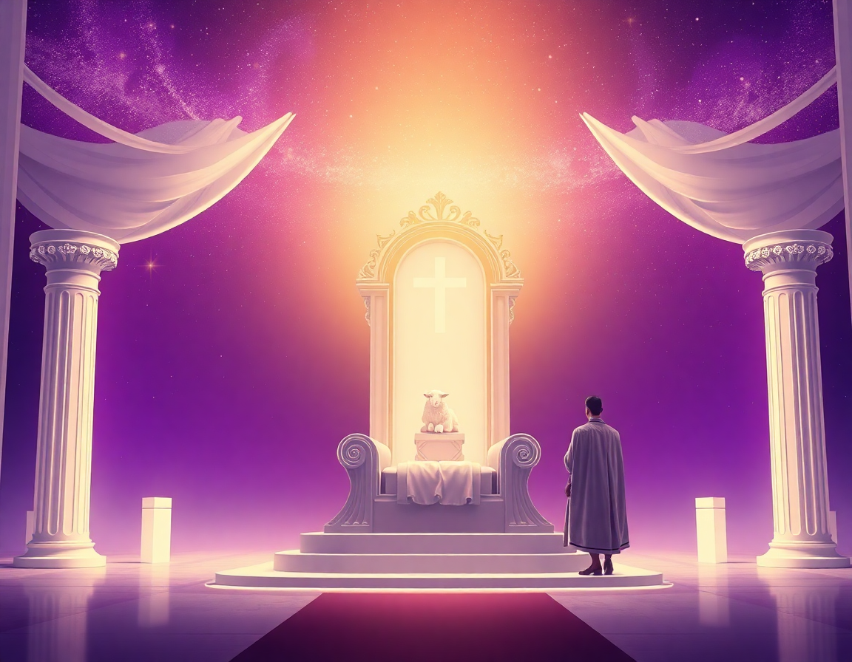
Global Outreach
Missions
God’s Promises to the Righteous Define Who You Are in Christ!
Reigning as Kings: Lambano Identity
Romans 5:17(NIV); Abraham's Example
Receiving (Lambano) God's abundant grace and righteousness causes you to reign in life as kings. Abraham's faith in God's promise made him the father of many nations - a model of taking hold of God's promise against all odds.
The Power of Belief and Declaration
To believe the promise of righteousness means to speak it - 'I am the righteousness of God in Christ Jesus' - and acknowledge every good thing God says about you (2 Corinthians 4:13(NIV); Philemon 1:6(NKJV))
19 | Page

Slide 56
Global Outreach
Missions
God’s Promises to the Righteous Define Who You Are in Christ!
Romans 5:17(NIV)
¹⁷ For if, by the trespass of the one man, death reigned through that one man, how much more will those who receive God’s abundant provision of grace and of the gift of righteousness reign in life through the one man, Jesus Christ
2 Corinthians 4:13(NIV)
¹³ It is written: “I believed, therefore, I have spoken.” With that same spirit of faith we also believe and therefore speak
Philemon 1:6(NKJV)
⁶ That the sharing of your faith may become effective by the acknowledgement of every good thing that is in you in Christ Jesus.
19 | Page

Slide 57

Global Outreach
Missions
God’s Promises to the Righteous Define Who You Are in Christ!
What does it mean to believe the promise of righteousness?
To be declared righteous in God’s sight means being justified —forgiven, made innocent, and treated as though you have perfectly fulfilled God’s law, all because of faith in Jesus Christ. This righteousness is not earned but given by God through Christ’s sacrifice.
As a result, God sees you as flawless and guilt-free, and you now qualify for all the promises made to the righteous in Scripture. These promises include:
God’s favor, blessing, and protection
Peace, confidence, and prosperity
Deliverance in trouble
A lasting legacy for your family
Answered prayers and fulfilled desires
20 | Page

Slide 58

Lesson 4
The Prayers of the Righteous are Powerful & Effective
Global Outreach
Missions

Slide 59





Global Outreach
Missions
The Prayers of the Righteous: Power & Authority
James 5:16 (AMPC)
The earnest (heartfelt, continued) prayer of a righteous man makes tremendous power available [dynamic in its working].
My Prayers are Powerful Effective because I am the Righteousness of God in
Christ Jesus!
James 5:16 (NIV)
¹⁶ The prayer of a righteous person is powerful and effective.
22 | Page

Slide 60
Global Outreach
Missions
The Prayers of the Righteous: Power & Authority
Romans 5:17 (TPT)
¹⁷ Death once held us in its grip, and by the blunder of one man, death reigned as king over humanity. But now, how much more are we held in the grip of grace and continue reigning as kings in life, enjoying our regal freedom through the gift of perfect righteousness in the one and only Jesus, the Messiah!
22 | Page

Slide 61
Global Outreach
Missions
The Prayers of the Righteous: Power & Authority
Mark 11:23-24 (TPT)
²³ Listen to the truth I speak to you: Whoever says to this mountain with great faith and does not doubt, ‘Mountain, be lifted up and thrown into the midst of the sea,’ and believes that what he says will happen, it will be done. ²⁴ This is the reason I urge you to boldly believe for whatever you ask for in prayer—be convinced that you have received it and it will be yours.
22 | Page

Slide 62
Global Outreach
Missions
The Prayers of the Righteous: Power & Authority
Job 22:21; 28 (AMP)
²¹ “Now yield and submit yourself to Him [agree with God and be conformed to His will] and be at peace; ²⁸ “You will also decide and decree a thing, and it will be established for you; And the light [of God’s favor] will shine upon your ways.
22 | Page

Slide 63
Global Outreach
Missions
The Prayers of the Righteous: Power & Authority
Job 22:29 (NLT); 30 (AMP)
²⁹ If people are in trouble and you say, ‘Help them,’
God will save them. (NLT)
³⁰ “He will even rescue the one [for whom you intercede] who is not innocent;
And he will be rescued through the cleanness of your hands.” (AMP)
22 | Page

Slide 64
Global Outreach
Missions
The Prayers of the Righteous: Power & Authority
1 Timothy 2:1; 3 (NLT); 2(TPT)
¹ I urge you, first of all, to pray for all people. Ask God to help them; intercede on their behalf and give thanks for them.
² And pray for every political leader and representative, so that we would be able to live tranquil, undisturbed lives, as we worship the awe-inspiring God with pure hearts. (TPT) ³ This is good and pleases God our Savior,
22 | Page

Slide 65
Global Outreach
Missions
The Prayers of the Righteous: Power & Authority
1 Timothy 2:4(TPT); 5-6 (NLT)
⁴ He longs for everyone to embrace His life and return to the full knowledge of the truth. (TPT)
⁵ For, There is one God and one Mediator who can reconcile God and humanity—the man Christ Jesus. ⁶ He gave his life to purchase freedom for everyone. This is the message God gave to the world at just the right time.
22 | Page

Slide 66
Global Outreach
Missions
The Prayers of the Righteous: Power & Authority
1 John 5:13-15 (TPT)
¹³ I’ve written this letter to you who believe in the name of the Son of God so that you will be assured and know without a doubt that you have eternal life. ¹⁴ Since we have this confidence, we can also have great boldness before Him, for if we ask anything agreeable to His will, He will hear us.
22 | Page

Slide 67
Global Outreach
Missions
The Prayers of the Righteous: Power & Authority
1 John 5:13-15 (TPT)
¹⁵ And if we know that He hears us in whatever we ask, we also know that we have obtained the requests we ask of Him.
22 | Page

Slide 68

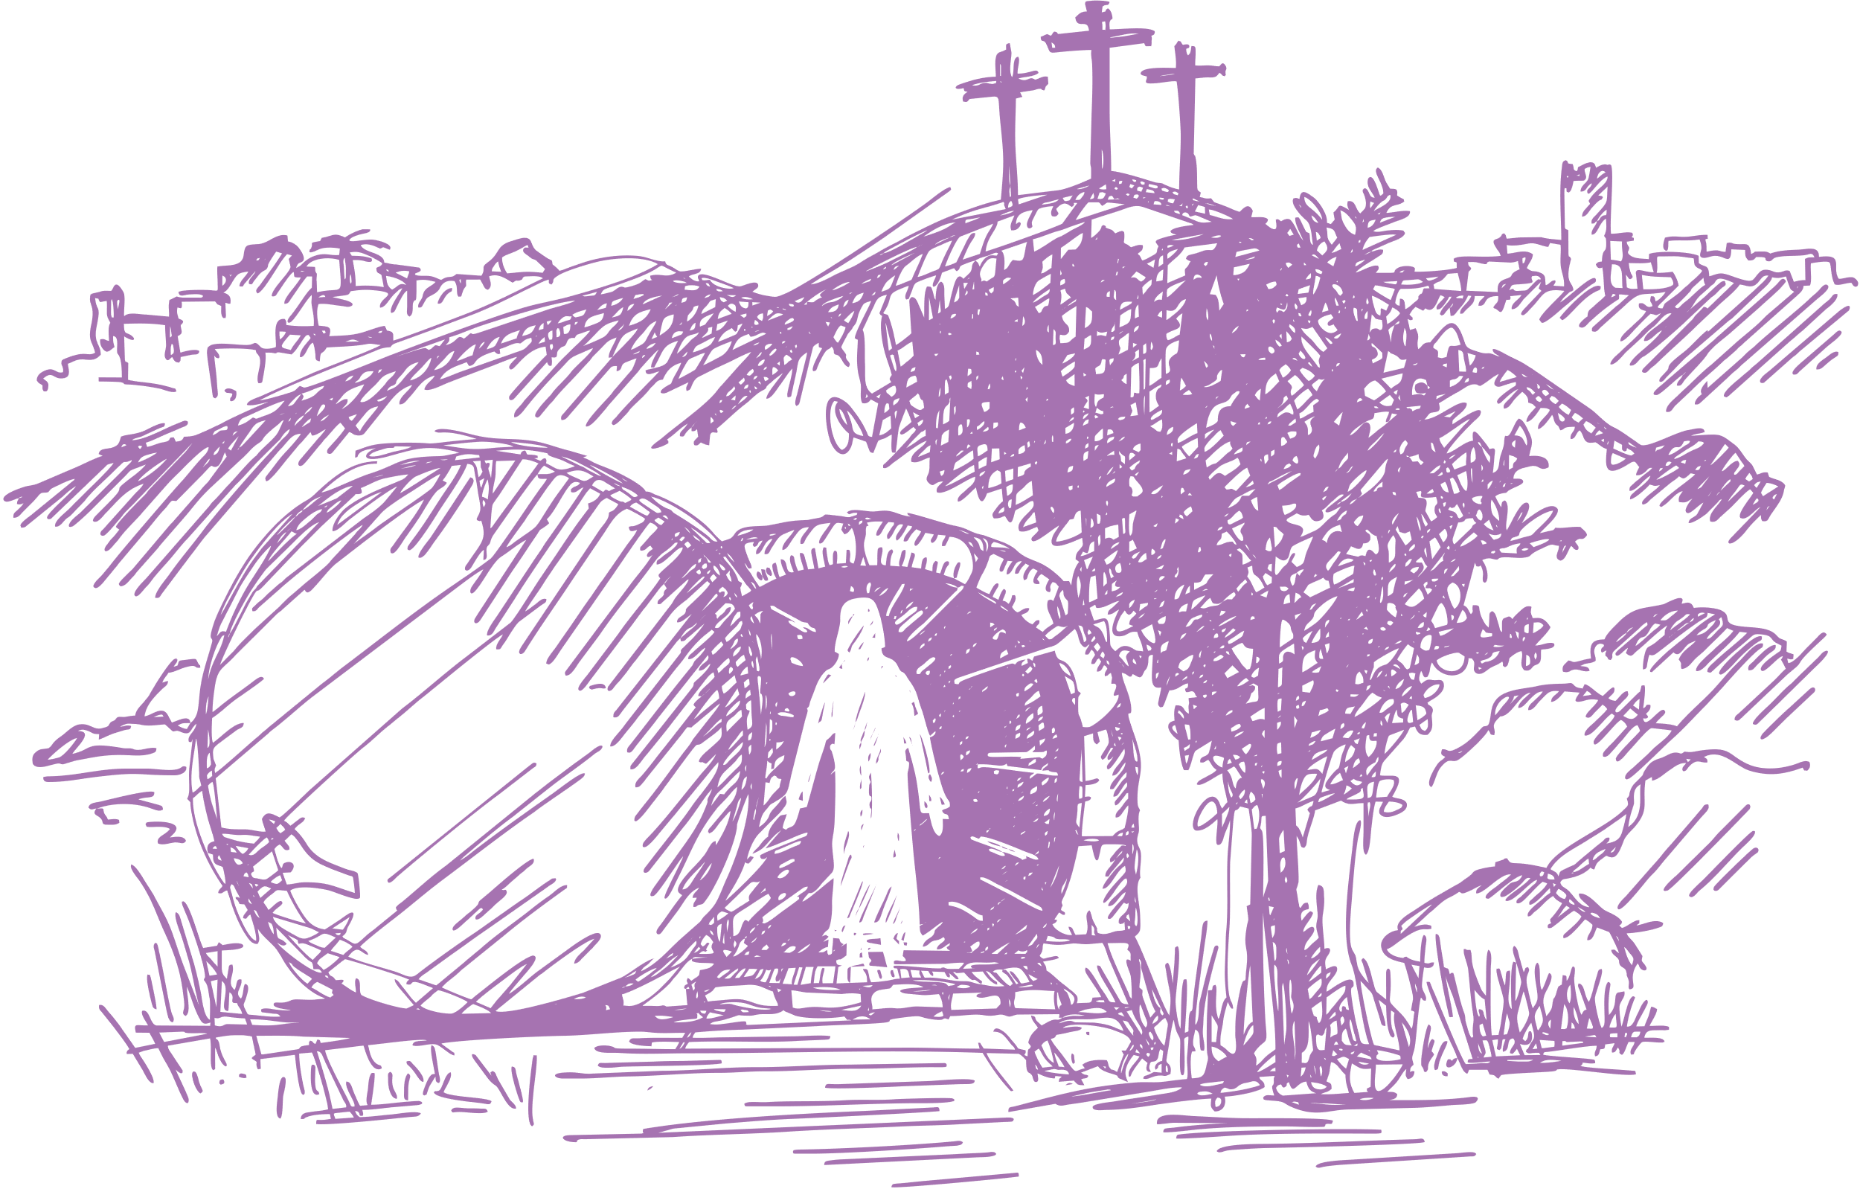

Global Outreach
Missions
You Have Authority in Christ
Ephesians 1:19–20(TPT)
¹⁹ I pray that you will continually experience the immeasurable greatness of God’s power made available to you through faith. Then your lives will be an advertisement of this immense power as it works through you! This is the mighty power ²⁰ that was released when God raised Christ from the dead and exalted him to the place of highest honor and supreme authority in the heavenly realm!.
23 | Page

Slide 69
Global Outreach
Missions
You Have Authority in Christ
Ephesians 2:5-6 (TPT)
⁵ Even when we were dead and doomed in our many sins, He united us into the very life of Christ and saved us by His wonderful grace! ⁶ He raised us up with Christ the exalted One, and we ascended with Him into the glorious perfection and authority of the heavenly realm, for we are now co-seated as one with Christ!
23 | Page

Slide 70
Global Outreach
Missions
You Have Authority in Christ
Psalm 8:3-8(TPT)
³ Look at the splendor of your skies, your creative genius glowing in the heavens. When I gaze at your moon and your stars, mounted like jewels in their settings, I know you are the fascinating artist who fashioned it all! But I have to ask this question: ⁴ Why would you bother with puny, mortal man or care about human beings? ⁵ Yet what honor you have given to men, created only a little lower than Elohim, crowned with glory and magnificence
23 | Page

Slide 71
Global Outreach
Missions
You Have Authority in Christ
⁶ You have delegated to them rulership over all you have made, with everything under their authority, placing earth itself under the feet of your image-bearers. ⁷⁻⁸ All the created order and every living thing of the earth, sky, and sea— the wildest beasts and all that move in the paths of the sea — everything is in submission to Adam’s sons.
23 | Page

Slide 72
Global Outreach
Missions
You Have Authority in Christ
Luke 10:18-20 (TPT)
¹⁸ Jesus replied, “While you were ministering, I watched Satan topple until he fell suddenly from heaven like lightning to the ground. ¹⁹ Now you understand that I have imparted to you my authority to trample over his kingdom. You will trample upon every demon before you and overcome every power Satan possesses. Absolutely nothing will harm you as you walk in this authority. ²⁰ However, your real source of joy isn’t merely that these spirits submit to your authority, but that your names are written in the journals of heaven and that you belong to God’s kingdom. This is the true source of your authority.
24 | Page

Slide 73
Global Outreach
Missions
The Prayers of the Righteous: Power & Authority
John 12:49-50 (TPT)
⁴⁹ For I’m not speaking as someone who is self-appointed, but I speak by the authority of the Father himself who sent me, and who instructed me what to say. ⁵⁰ And I know that the Father’s commands result in eternal life, and that’s why I speak the very words I’ve heard him speak.
22 | Page

Slide 74
Global Outreach
Missions
The Prayers of the Righteous: Power & Authority
Luke 7:8-10 (TPT)
⁸ I am an ordinary man. Yet I understand the power of authority, and I see that authority operating through you. I have soldiers under me who obey everything I command. I also have authorities over me whom I likewise obey. So Master, just speak the word and healing will flow.”
⁹ Jesus marveled at this. He turned around and said to the crowd who had followed Him, “Listen, everyone! Never have I found among the people of God a man like this who believes so strongly in Me.”
¹⁰ Jesus then spoke the healing word from a distance.
When the man’s friends returned to the home, they found the servant completely healed and doing fine.
22 | Page

Slide 75
Global Outreach
Missions
The Prayers of the Righteous: Power & Authority
Luke 9:1-2 (TPT)
¹ Jesus summoned together his twelve apostles and imparted to them authority over every demon and the power to heal every disease. ² Then he commissioned them to proclaim God’s kingdom and to heal the sick to demonstrate that the kingdom had arrived. As he sent them out, he gave them these instructions:
22 | Page

Slide 76
Global Outreach
Missions
The Prayers of the Righteous: Power & Authority
Acts 4:6-14 (TPT)
⁶ Annas the high priest was there with Caiaphas, John, Alexander, and others who were members of the high priest’s family. ⁷ They made Peter and John stand in front of the council as they questioned them, saying, “Tell us, by what power and authority have you done these things?” ⁸ Peter, filled with the Holy Spirit, answered, “Respected elders and leaders of the people, listen. ⁹ Are we being put on trial today for doing an act of kindness by healing a frail, crippled man? Well then, ¹⁰ you and everyone else in Israel should know that it is by the power of the name of Jesus that the crippled man stands here today completely healed!
You crucified Jesus Christ of Nazareth, but God raised him from the dead.
22 | Page

Slide 77
Global Outreach
Missions
The Prayers of the Righteous: Power & Authority
Acts 4:6-14 (TPT)
¹¹ This Jesus is ‘the stone that you, the builders, have rejected, and now he has become the cornerstone!’ ¹² There is no one else who has the power to save us, for there is only one name to whom God has given authority by which we must experience salvation: the name of Jesus.” ¹³ The council members were astonished as they witnessed the bold courage of Peter and John, especially when they discovered that they were just ordinary men who had never had religious training. Then they began to understand the effect Jesus had on them simply by spending time with him. ¹⁴ Standing there with them was the healed man, and there was nothing further they could say.”
22 | Page

Slide 78


Global Outreach
Missions
You Have Authority in Christ
As a believer, you share in the same power and authority as Jesus, seated with Him in the heavenly realm. Because of your union with Christ:
· The resurrection power of God works through you (Ephesians 1:19–20 (TPT))
· You are co-seated with Christ in heavenly authority (Ephesians 2:5–6 (TPT))
· You have been given authority over all the power of the enemy (Luke 10:18-20 (TPT))
· You are empowered to speak God’s Word and will into the earth, just as Jesus did.
Your Identity and Power in Christ
· You are crowned with glory and delegated authority over the earth (Psalm 8).
· Your prayers are powerful and effective.
· You speak with God's voice when you declare His Word (Proverbs 23:16 (TPT)).
How to Use Your Authority
Speak what the Father says, just like Jesus (John 12:49–50(TPT)).
Declare healing, deliverance, and truth by speaking the name of Jesus (Luke 7:8–10; Acts 4:10–12).
· Activate the Kingdom of God by declaring God’s Word—the Kingdom is voice-activated.
· Your words carry power—they bring life or death (Proverbs 18:21(TPT & AMPC).
23 | Page

Slide 79
Global Outreach
Missions
You Have Authority in Christ
Proverbs 23:15-16(TPT)
¹⁵ My beloved child, when your heart is full of wisdom, my heart is full of gladness. ¹⁶ And when you speak anointed words, we are speaking mouth to mouth!
23 | Page

Slide 80

Global Outreach
Missions
You Have Authority in Christ
Kingdom Authority: Speaking Life and Healing
Living and Praying as Jesus Did
As co-seated with Christ in the heavenly realm, you speak God's word with authority. the same Spirit that raised Jesus from the dead works in you - your words of faith manifest healing, blessing, and God's will on earth (Ephesians 2:5-6 (TPT); Luke 10:18-20(TPT).
The Power of Your Words
Life and death are in the power of the tongue (Proverbs 18:21)(AMPC, TPT). Speak life and blessing - over yourself, your family, and the world.
24 | Page

Slide 81
Global Outreach
Missions
You Have Authority in Christ
Proverbs 18:21 (TPT, AMPC)
²¹ Your words are so powerful that they will kill or give life (TPT)
²¹ Death and life are in the power of the tongue, and they who indulge in it shall eat the fruit of it [for death or life]. (AMPC)
24 | Page

Slide 82

Global Outreach
Missions
You Have Authority in Christ
You are not powerless.
As a child of God, you have been given divine authority to speak life, enforce God’s will, and manifest His Kingdom on earth.
Your words, aligned with God’s Word, carry supernatural power.
25 | Page

Slide 83

Lesson 5
Healing Belongs to You! Divine Health Defines You in Christ.
Global Outreach
Missions

Slide 84
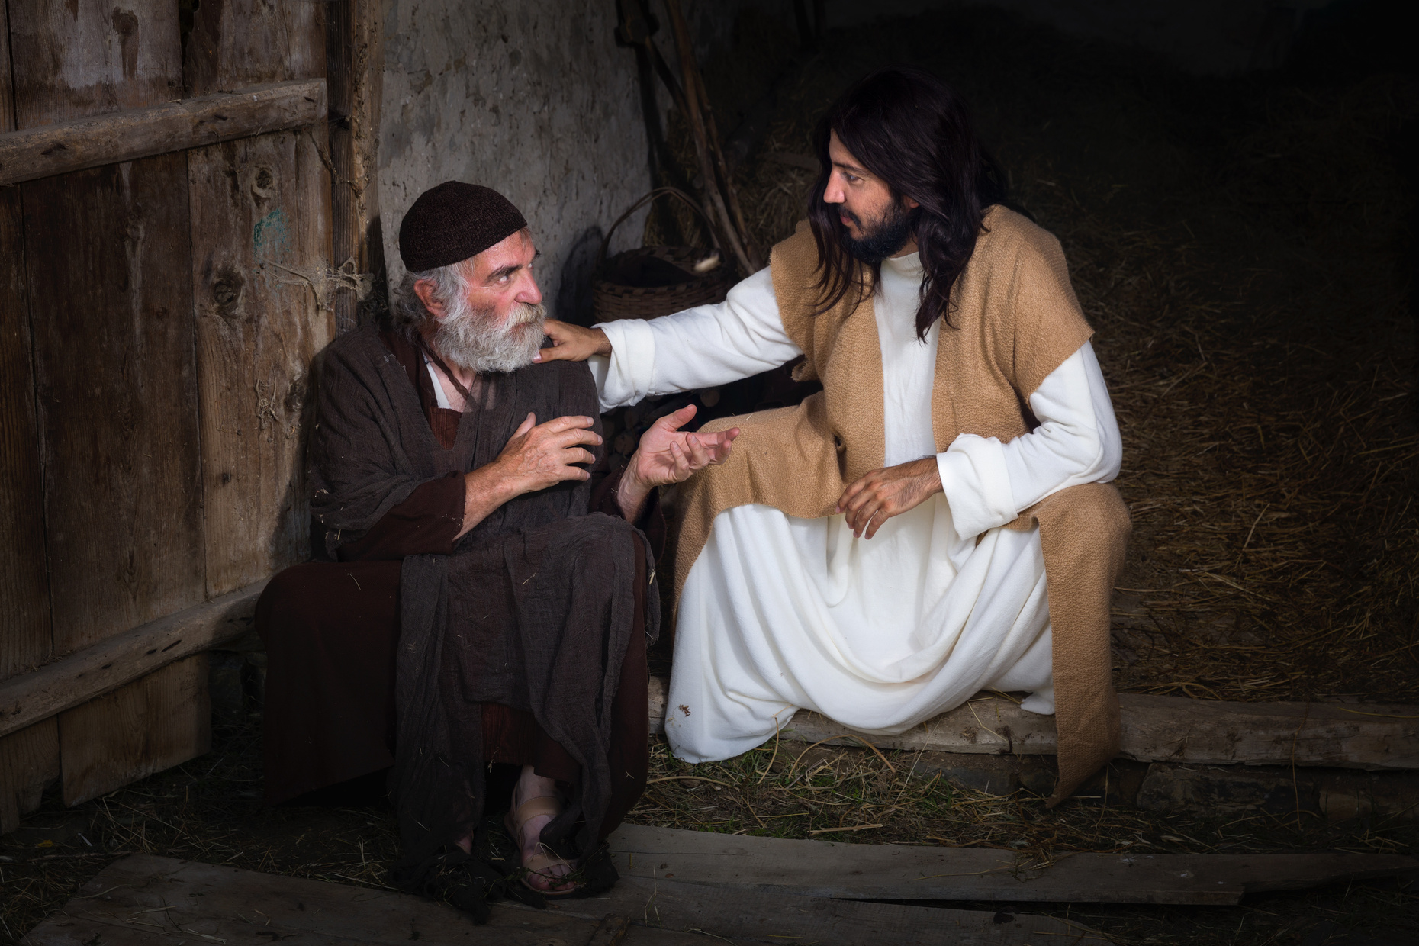


Healing and Divine Health: Your Birthright in Christ
Victory Over Sickness
As you embrace God's words of righteousness and health, you reign over sickness in Jesus name, speaking life and healing as Jesus and the apostles did. All God's promises concerning health are 'Yes' in Christ (2 Corinthians 1:20).
Heirs of God's Healing
As a child of God, healing and divine health are your inheritance. Jesus paid for your healing through the cross, and God's promises take precedence over your family genetics - His DNA and Spirit dwell in you (Romans 8:16-17(TPT); 17 (NLT), Isaiah 53:4 (NKJV), Matthew 8:16-17(CEV), 1 Peter 2:24 (NIV).
Who is God?
He is Jehovah Rapha:
The Lord Who Heals You! Christ in you is the hope (a confident expectation) of you experiencing His glory -
DIVINE HEALTH
Global Outreach
Missions
27 | Page

Slide 85
Healing and Divine Health: Your Birthright in Christ
¹⁷ And since we are joined to Christ, we also inherit all that He is and all that He has (TPT).
Romans 8:16-17 (TPT)
¹⁶ For the Holy Spirit makes God’s fatherhood real to us as He whispers into our innermost being, “You are God’s beloved child!” And since we are His true children, we qualify to share all His treasures, for indeed, we are heirs of God Himself.
¹⁷ And since we are His children, we are His heirs. In fact, together with Christ we are heirs of God’s glory. But if we are to share His glory, we must also share His suffering. (NLT).
Global Outreach
Missions
27 | Page

Slide 86
Healing and Divine Health: Your Birthright in Christ
Matthew 8:16-17 (CEV)
¹⁶ That evening many people with demons in them were brought to Jesus. And with only a word he forced out the evil spirits and healed everyone who was sick. ¹⁷ So God's promise came true, just as the prophet Isaiah had said,
“He healed our diseases
and made us well.”
Isaiah 53:4 (NKJV)
⁴ But He was wounded for our transgressions, He was bruised for our iniquities; The chastisement for our peace was upon Him, And by His stripes we are healed
1 Peter 2:24 (NIV)
²⁴ He himself bore our sins” in His body on the cross, so that we might die to sins and live for righteousness; “by His wounds you have been healed
Global Outreach
Missions
27 | Page

Slide 87
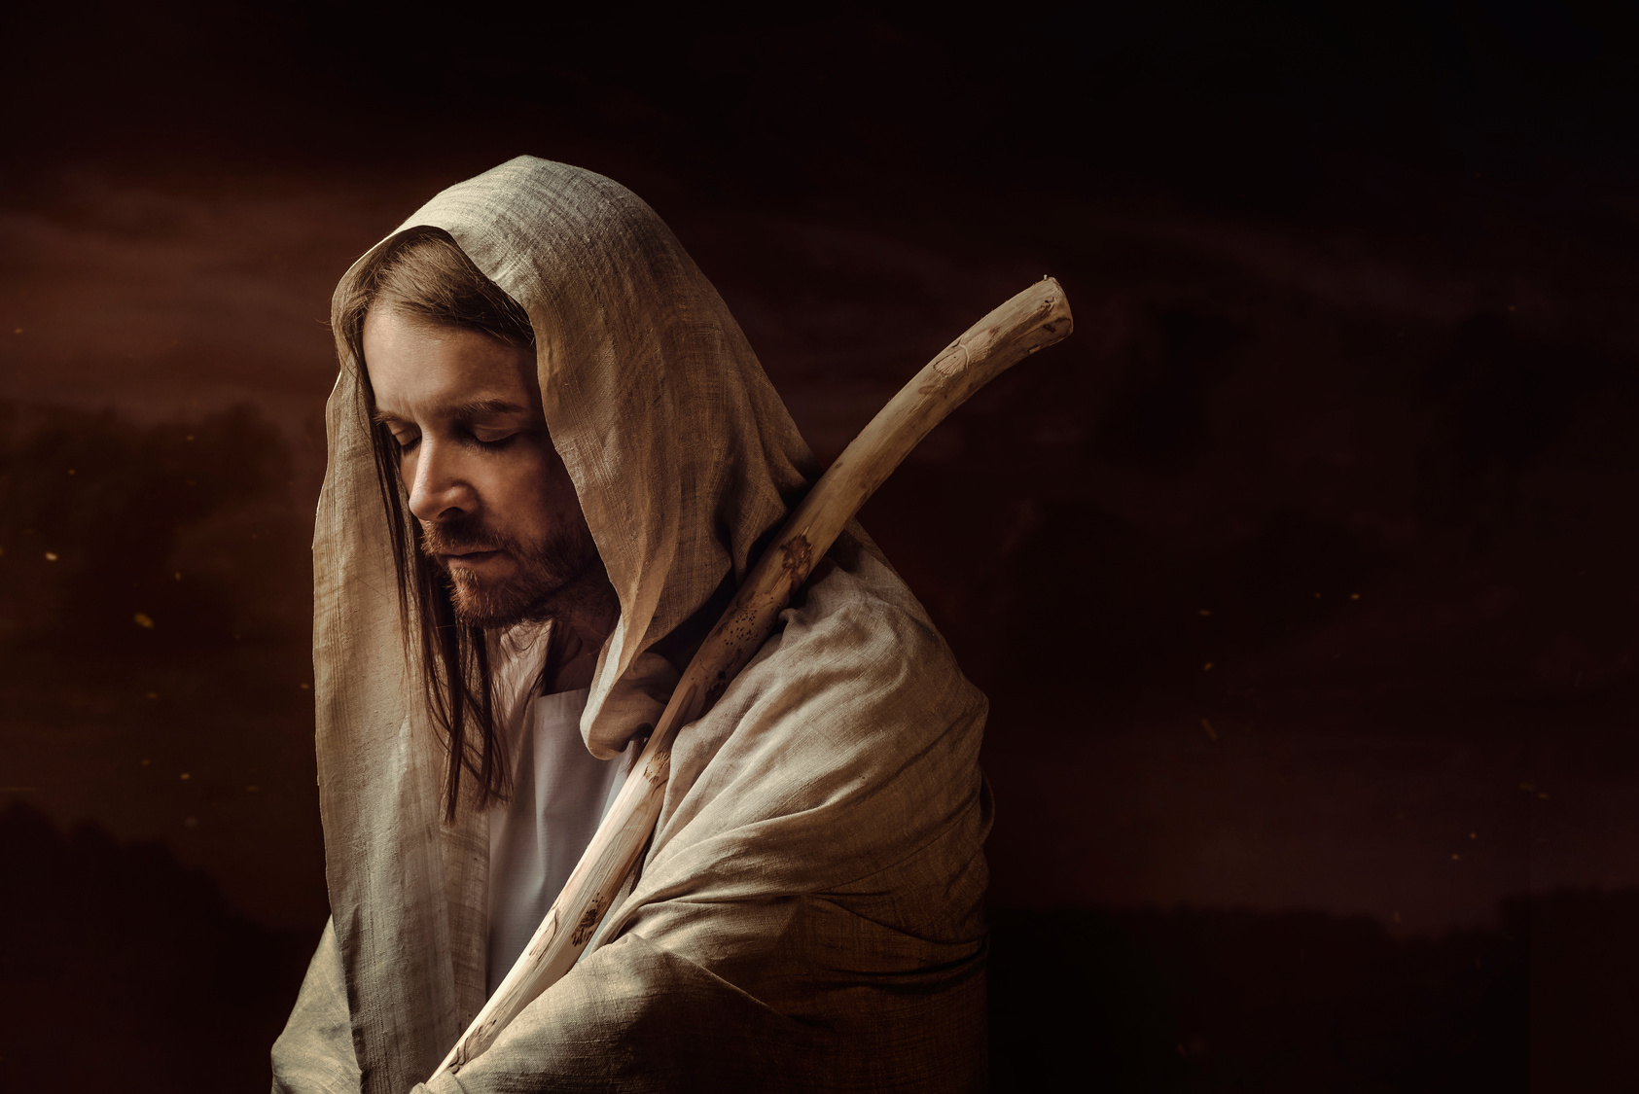


Jesus Paid the Price for Your Healing!
Isaiah 53:4 prophesied that Jesus would bear both our sins and sicknesses — His suffering purchased our peace and healing.
Matthew 8:16–17 shows that Jesus’ healing ministry fulfilled Isaiah’s prophecy, proving that this promise includes physical healing, not just spiritual restoration.
1 Peter 2:24 confirms that by Jesus’ wounds, you were healed — past tense— declaring healing as a finished work.
Galatians 2:20 and other scriptures declare your new identity in Christ: you are dead to sin and sickness and alive to righteousness and divine health. Jesus' life now energizes every part of your body.
Your New Identity Overrides Natural Limitations
Romans 9:6–9 (MSG) teaches that God’s promise overrides natural lineage -you are defined not by your earthly DNA, but by God’s promise and Spirit.
As a believer, you carry God’s DNA, and your body is the temple of the Holy Spirit (1 Corinthians 3:16) -sickness has no legal right to remain in you.
Jesus not only forgave your sins but also secured your healing. You now live by God’s promise, not human genetics, and your body is empowered by the life and health of Christ.
Global Outreach
Missions
28 | Page

Slide 88
Jesus Paid the Price for Your Healing!
Romans 9:6-9 (MSG)
⁷ It wasn’t Abraham’s sperm that gave identity here, but God’s promise. Remember how it was put: “Your family will be defined by Isaac”? ⁸ That means that Israelite identity was never racially determined by sexual transmission, but it was God-determined by promise. ⁹ And that’s not the only time. To Rebecca, also, a promise was made that took priority over genetics.
Romans 9:6-9 (MSG)
⁶ Don’t suppose for a moment, though, that God’s Word has malfunctioned in some way or other. The problem goes back a long way. From the outset, not all Israelites of the flesh were Israelites of the spirit.
Global Outreach
Missions
28 | Page

Slide 89
Jesus Paid the Price for Your Healing!
Galatians 2:20
I am a new creation in Christ Jesus. I HAVE BEEN healed!
My old identity died with Jesus. I am dead to sin & sickness and alive to righteousness and Divine Health! Jesus dispensed His Life into mine. Every cell of my body permeates with the Life of God!.
Matthew 8:16-17 (CEV)
¹⁶ That evening many people with demons in them were brought to Jesus. And with only a word he forced out the evil spirits and healed everyone who was sick. ¹⁷ So God's promise came true, just as the prophet Isaiah had said “He healed our diseases and made us well.
Global Outreach
Missions
28 | Page

Slide 90
Global Outreach
Missions
Jesus Purchased Your Freedom from the Curse of Sickness & Declares You Righteous & Healed in Him
Believe and Embrace What God Says About You:
3 John 2 & Proverbs 4:20–22: Prosperity and health flow from a prosperous soul—believing and meditating on God’s Word brings healing to your whole body.
Guard your heart—the voice of truth brings health and peace; the voice of accusation brings fear, sickness, and defeat.
Proverbs 14:30 & 17:22: Peaceful, joyful hearts bring life and healing; negative emotions bring decay.
Psalm 107:20: God sends His Word to heal and deliver.
Matthew 13:58: Offense and unbelief hinder healing—receive Jesus as your Healer
Jesus Redeemed You from the Curse and Released the Blessing:
Galatians 3:13–14: Jesus redeemed you from the curse of the law (sickness, disease, etc.— Deut. 28) by becoming a curse for you. Now, the blessing of Abraham—righteousness by faith—belongs to you!
Romans 8:11: The same Spirit who raised Jesus from the dead gives life to your mortal body.
Romans 5:17: When you receive (“Lambano”) God’s gift of righteousness, you reign in life over sickness and disease through Jesus.
Exodus 23:25-26: God's blessing removes sickness and promises a full lifespan.
Psalm 103:1-5: God forgives, heals, redeems, satisfies, and renews your youth like the eagle’s.
29 | Page

Slide 91
Global Outreach
Missions
Psalm 103:1-5 (NKJV)
¹ “Bless the Lord, O my soul; And all that is within me, bless His holy name! ² Bless the Lord, O my soul, And forget not all His benefits: ³ Who forgives all your iniquities, Who heals all your diseases, ⁴ Who redeems your life from destruction, Who crowns you with lovingkindness and tender mercies,⁵ Who satisfies your mouth with good things, So that your youth is renewed like the eagle’s.
Exodus 23:25-26
²⁵ Worship the Lord your God, and his blessing will be on your food and water. I will take away sickness from among you, ²⁶ and none will miscarry or be barren in your land. I will give you a full life span.
29 | Page

Slide 92
Global Outreach
Missions
Proverbs 4:20–22 (NLT)
²⁰ My child, pay attention to what I say. Listen carefully to my words.
²¹ Don’t lose sight of them. Let them penetrate deep into your heart,
²² for they bring life to those who find them, and healing to their whole body.
²³ Guard your heart above all else, for it determines the course of your life.
3 John 2 (KJV)
² Beloved, I wish above all things that thou mayest prosper and be in health, even as thy soul prospereth.
29 | Page

Slide 93
Global Outreach
Missions
Proverbs 17:22 (AMP)
²² A happy heart is good medicine and a cheerful mind works healing, but a broken spirit dries up the bones
Psalm 107:20 (TPT)
²⁰ God spoke the words, “Be healed,” and we were healed, delivered from death’s door!
Proverbs 14:30 (AMPC, GNT)
³⁰ A calm undisturbed mind and heart are the life and health of the body, but envy, jealousy, and wrath are like rottenness of the bones.” (AMPC)
³⁰ Peace of mind makes the body healthy, but jealousy is like a cancer.” (GNT)
29 | Page

Slide 94
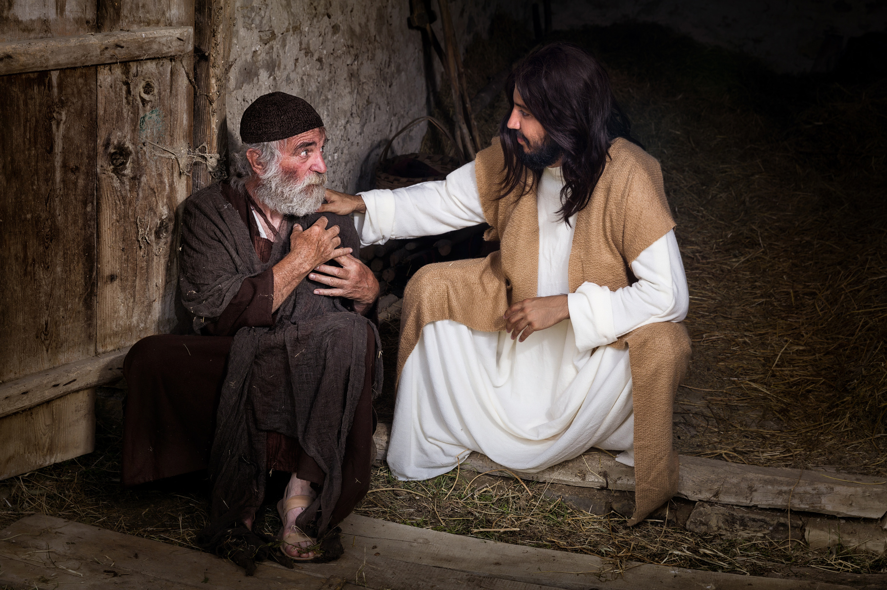
Use Your Authority and Speak Life
Jesus spoke healing words with authority and people were healed:
Leper (Matt. 8:2–3), Simon’s mother-in-law (Luke 4:39), Epileptic boy (Matt. 17:18).
Faith the size of a mustard seed can move mountains (Matt. 17:20; Mark 11:23–24).
Peter and Paul in Acts demonstrated the same authority:
Peter to crippled man (Acts 3:6): “Stand up and walk!”
Peter to bedridden man (Acts 9:34): “Jesus Christ heals you!”
Paul to demonized woman (Acts 16:18): “Come out in Jesus’ name!”
You are redeemed, righteous, and healed in Christ. The curse has no legal right to remain in your body. Embrace God's Word, guard your heart, and speak life with authority—because as Jesus is, so are you in this world!
Global Outreach
Missions
30 | Page

Slide 95
Global Outreach
Missions
Use Your Authority & Live by Every Word Your Father Says About You in Christ Matthew 4:4
Speak Life with Authority
Your words carry power (Proverbs 18:21)—choose life!
Speak healing and divine health over your body in Jesus' name.
Reject the accuser’s voice and symptoms of sickness.
Declare:
“Sickness, you have no right in my body! I am the righteousness of God in Christ, and divine health belongs to me in Jesus’ name!”
God’s Promises Are “Yes” in Christ
2 Corinthians 1:20 (NIV) – Every promise God made, including divine health, is YES in Christ.
Our response of “Amen” (agreement) gives glory to God.
You are defined by God’s Word, not symptoms or circumstances—agree with your Father!
31 | Page

Slide 96
Global Outreach
Missions
2 Corinthians 1:20 (NIV)
²⁰ No matter how many promises God has made, they are 'Yes' in Christ. And so through him the 'Amen' is spoken by us to the glory of God
Proverbs 18:21 (AMPC)
²¹ Death and life are in the power of the tongue, and they who indulge in it shall eat the fruit of it [for death or life].
31 | Page

Slide 97
Global Outreach
Missions
You Have Authority in Christ
Use your authority in Christ, align your words with God’s promises, and speak life daily— because His Word is your true identity.
32 | Page

Slide 98

Lesson 6
Abundant Provision is Your inheritance in Jesus.
You lack nothing in Him!
Global Outreach
Missions

Slide 99

You Are Blessed and Qualified Through Jesus
You Are Blessed and Provided For Because of Jesus
01
In the Old Covenant, blessings were conditional on obedience, and disobedience brought curses (Deuteronomy 28 (NIV)).
In the New Covenant, Jesus took the curse of the law upon Himself (Galatians 3:8–14 (TPT), and by faith in Him, you are made righteous and receive the blessings of Abraham.
02
03
You are no longer under the curse of lack, fear, and failure—Jesus qualified you for abundant blessing and divine provision.
34 | Page

Slide 100
You Are Blessed and Qualified Through Jesus
Deuteronomy 28:15-16; 38; 43-44 (NIV)
¹⁵ However, if you do not obey the Lord your God and do not carefully follow all his commands and decrees I am giving you today, all these curses will come on you and overtake you: ¹⁶ You will be cursed in the city and cursed in the country. ³⁸ You will sow much seed in the field but you will harvest little, because locusts will devour it. ⁴³ The foreigners who reside among you will rise above you higher and higher, but you will sink lower and lower. ⁴⁴ They will lend to you, but you will not lend to them. They will be the head, but you will be the tail.
34 | Page

Slide 101
You Are Blessed and Qualified Through Jesus
Deuteronomy 28:48; 66(NIV)
⁴⁸ therefore in hunger and thirst, in nakedness and dire poverty, you will serve the enemies the Lord sends against you. He will put an iron yoke on your neck until he has destroyed you.
⁶⁶ You will live in constant suspense, filled with dread both night and day, never sure of your life.
34 | Page

Slide 102
You Are Blessed and Qualified Through Jesus
Deuteronomy 28:43,44 (NIV),48(NLT),66(AMP)
⁴³ The foreigners who reside among you will rise above you higher and higher, but you will sink lower and lower. ⁴⁴ They will lend to you, but you will not lend to them. They will be the head, but you will be the tail. (NIV)
⁴⁸ You will be left hungry, thirsty, naked, and lacking in everything. (NLT)
⁶⁶Your life shall hang in doubt before you; day and night you shall be worried, and have no assurance of your life. (AMP)
34 | Page

Slide 103
You Are Blessed and Qualified Through Jesus
Galatians 3: 8-14 (TPT)
⁸ What’s more, the Scriptures looked forward to this time when God would declare the Gentiles to be righteous because of their faith. God proclaimed this good news to Abraham long ago when he said, “All nations will be blessed through you.”
⁹ So all who put their faith in Christ share the same blessing Abraham received because of his faith.
34 | Page

Slide 104
You Are Blessed and Qualified Through Jesus
Galatians 3: 8-14(TPT)
¹⁰And all who depend on the Law [who are seeking to be justified by obedience to the Law] are under a curse and doomed to disappointment and destruction, for it is written in the Scriptures, Cursed be everyone who does not continue to abide by all the precepts and commands written in the Book of the Law and to practice them.
¹¹ So it is clear that no one can be made right with God by trying to keep the law.
For the Scriptures say, “It is through faith that a righteous person has life.”
34 | Page

Slide 105
You Are Blessed and Qualified Through Jesus
Galatians 3: 8-14 (TPT)
¹² This way of faith is very different from the way of law, which says, “It is through obeying the law that a person has life.”
¹³ Yet, Christ paid the full price to set us free from the curse of the law. He absorbed the curse completely as he became a curse in our place. For it is written: “Everyone who is hung upon a tree is cursed.”
¹⁴ Jesus Christ dissolved the curse from our lives, so that in him all the blessings of Abraham can be poured out upon gentiles. And now through faith we receive the promised Holy Spirit who lives in us.
34 | Page

Slide 106
Global Outreach
Missions
You Are Blessed and Provided For Because of Jesus
Seek First God’s Kingdom and Righteousness
Jesus taught in Matthew 6:25–33 that worry about provision is unnecessary; your heavenly Father knows your needs.
Instead, seek His gift of righteousness, and everything else (food, clothing, provision) will be added to you.
You are more valuable to God than the birds He feeds daily—trust in His care.
35 | Page

Slide 107
Global Outreach
Missions
You Are Blessed and Provided For Because of Jesus
Matthew 6:25-32 (AMPC),33(NIV)
²⁵ Therefore I tell you, stop being perpetually uneasy (anxious and worried) about your life, what you shall eat or what you shall drink; or about your body, what you shall put on. Is not life greater [in quality] than food, and the body [far above and more excellent] than clothing?
²⁶Look at the birds of the air; they neither sow nor reap nor gather into barns, and yet your heavenly Father keeps feeding them. Are you not worth much more than they? Aren't you far more valuable to Him than they are?
²⁷And who of you by worrying and being anxious can add one unit of measure (cubit) to his stature or to the span of his life? (AMPC)
35 | Page

Slide 108
Global Outreach
Missions
You Are Blessed and Provided For Because of Jesus
Matthew 6:25-32 (AMPC),33(NIV)
²⁸ And why should you be anxious about clothes? Consider the lilies of the field and learn thoroughly how they grow; they neither toil nor spin.
²⁹Yet I tell you, even Solomon in all his magnificence (excellence, dignity, and grace) was not arrayed like one of these.
³⁰ But if God so clothes the grass of the field, which today is alive and green and tomorrow is tossed into the furnace, will He not much more surely clothe you, O you of little faith? (AMPC)
35 | Page

Slide 109
Global Outreach
Missions
You Are Blessed and Provided For Because of Jesus
Matthew 6:25-32 (AMPC),33(NIV)
³¹ Therefore do not worry and be anxious, saying, What are we going to have to eat? or, What are we going to have to drink? or, What are we going to have to wear?
³² For the Gentiles (heathen) wish for and crave and diligently seek all these things, and your heavenly Father knows well that you need them all. (AMPC)
³³ But seek first His kingdom and His righteousness, and all these things will be given to you as well. (NIV)
35 | Page

Slide 110
Global Outreach
Missions
You Are Blessed and Provided For Because of Jesus
God’s Financial Promises Are “Yes” in Christ
2 Corinthians 1:20 declares that all of God’s promises are affirmed in Jesus.
In Christ, you are clothed in righteousness and united with Him—His blessings are yours.
As His bride, you share in His identity, authority, and provision.
36 | Page

Slide 111
Global Outreach
Missions
You Are Blessed and Provided For Because of Jesus
2 Corinthians 1:20 (AMPC)
²⁰ For as many as are the promises of God, they all find their Yes [answer] in Him [Christ]. For this reason we also utter the Amen (so be it) to God through Him to the glory of God
.
36 | Page

Slide 112


Global Outreach
Missions
You Are Blessed and Provided For Because of Jesus
Promises for Your Finances in Christ:
Provision: God supplies all your needs (Philippians 4:19) NLT.
Abundance: You’ll have more than enough to be generous (2 Corinthians 9:8–11) AMPC.
Wisdom: Christ is your wisdom for financial decisions (1 Corinthians 1:24, Proverbs 8).
Success & Guidance: Commit your plans to God and they will succeed (Proverbs 16:3, Isaiah 48:17).
Prosperity in Hard Times: Even in famine, you will have more than enough (Psalm 112:6–7, Psalm 37:18–19).
37 | Page

Slide 113
Global Outreach
Missions
You Are Blessed and Provided For Because of Jesus
Philippians 4:19 (NLT)
¹⁹ And this same God who takes care of me will supply all your needs from His glorious riches, which have been given to us in Christ Jesus.
37 | Page

Slide 114
Global Outreach
Missions
You Are Blessed and Provided For Because of Jesus
2 Corinthians 9:8 (AMPC)
⁸ And God is able to make all grace (every favor and earthly blessing) come to you in abundance, so that you may always and under all circumstances and whatever the need be self-sufficient [possessing enough to require no aid or support and furnished in abundance for every good work and charitable donation].
37 | Page

Slide 115
Global Outreach
Missions
You Are Blessed and Provided For Because of Jesus
2 Corinthians 9:10-11 (NLT)
¹⁰ For God is the one who provides seed for the farmer and then bread to eat. In the same way, he will provide and increase your resources and then produce a great harvest of generosity in you.
¹¹ Yes, you will be enriched in every way so that you can always be generous. And when we take your gifts to those who need them, they will thank God.
37 | Page

Slide 116
Global Outreach
Missions
You Are Blessed and Provided For Because of Jesus
1 Corinthians 1:24 (NLT)
²⁴ But to those called by God to salvation, both Jews and Gentiles, Christ is the power of God and the wisdom of God.
Proverbs 8:12 (KJV), 18(NIV)
¹² I wisdom, dwell with prudence, and find out knowledge of witty inventions. (KJV)
¹⁸ With me are riches and honor, enduring wealth and prosperity. (NIV)
37 | Page

Slide 117
Global Outreach
Missions
You Are Blessed and Provided For Because of Jesus
Proverbs 16:3 (AMP)
³ Roll your works upon the Lord [commit and trust them wholly to Him; He will cause your thoughts to become agreeable to His will, and] so shall your plans be established and succeed.
Isaiah 48:17 (NKJV)
¹⁷ Thus says the LORD, your Redeemer, the Holy One of Israel: I am the LORD your God which teaches you to profit, who leads you by the way you should go.
37 | Page

Slide 118
Global Outreach
Missions
You Are Blessed and Provided For Because of Jesus
Psalm 112:6–7 (NLT)
⁶ Those who are righteous will be long remembered.
⁷ They do not fear bad news; they confidently trust the Lord to care for them
37 | Page

Slide 119
Global Outreach
Missions
You Are Blessed and Provided For Because of Jesus
Psalm 37:18–19 (NLT)
¹⁸ Day by day the LORD takes care of the righteous, and they will receive an inheritance that lasts forever. ¹⁹ They will not be disgraced in hard times; even in famine they will have more than enough.
Psalm 37:19 (NASB)
¹⁹ In the days of famine they will have abundance.
37 | Page

Slide 120



Global Outreach
Missions
You Are Blessed and Provided For Because of Jesus
Declaration of Faith
I am qualified, blessed, and empowered to prosper.
Jesus freed me from the curse and made me righteous.
Grace abounds to me so
I can bless others.
I reject fear, lack, and debt— and receive peace, abundance, and freedom in Jesus' name.
I lack nothing in Christ.
Even in famine,
I prosper.
38 | Page

Slide 121

Lesson 7
Rest in What God Says about Your Children & Grandchildren
Global Outreach
Missions

Slide 122





Global Outreach
Missions
Rest in What God Says about Your Children & Grandchildren
God's Promises Are Guaranteed in Christ
God's promises are "Yes" in Christ, and the Holy Spirit guarantees that these promises will be fulfilled.
2 Corinthians 1:20-22 (NIV), 1:22 (NLT) |
Psalm 103:17 (TPT)
40 | Page

Slide 123
Global Outreach
Missions
Rest in What God Says about Your Children & Grandchildren
²⁰ For no matter how many promises God has made, they are “Yes” in
Christ. And so, through Him the “Amen” is spoken by us to the glory of God. ²¹ Now it is God
who makes both us and you stand firm in Christ. He anointed us, ²² set His seal of ownership on
us, and put His Spirit in our hearts as a deposit, guaranteeing what is to come
2 Corinthians 1:20-22(NIV)
40 | Page

Slide 124
Global Outreach
Missions
Rest in What God Says about Your Children & Grandchildren
²² and He has identified us as His own by placing the Holy Spirit in our hearts as the first
installment that guarantees everything He
has promised us
2 Corinthians 1:22 (NLT)
40 | Page

Slide 125
Global Outreach
Missions
Rest in What God Says about Your Children & Grandchildren
But Lord, Your endless love stretches from
one eternity to the other, unbroken and
unrelenting toward those who fear You and those who bow facedown in awe before You.
Your faithfulness to keep every gracious promise You've made passes from parents, to children, to grandchildren, and beyond.
Psalm 103:17 (TPT)
40 | Page

Slide 126




Rest in What God Says about Your Children & Grandchildren
Global Outreach
Missions
God's Specific Promises for Children & Grandchildren
Your good Father has promised to pour His Spirit upon your children. He said His Spirit will not
leave them, and His word will be spoken from their lips. What a powerful promise of God!
Especially when we remember that 2 Corinthians 1:22 says that the Spirit of God is what
guarantees the fulfillment of God’s promise to you for your children & your grandchildren.
Scripture verses promise peace, protection, blessings, salvation, and the indwelling of the Holy Spirit for children and future generations.
God's covenant and blessings extend from parents to children and grandchildren.
BIBLE REFERENCES
Isaiah 54:13(AMPC) | Isaiah 44:1-3 (TPT), 5(NIV) | Isaiah 59:20-21(NLT) | Isaiah 49:23 & 25(NIV) | Proverbs 11:21(TLB) | Galatians 3:13-14(AMPC) | Psalm 115:14-15(TPT) | Proverbs 31:10, 26, 28 AMPC | Psalm 112:1-2(TPT)
41 | Page

Slide 127
Rest in What God Says about Your Children & Grandchildren
Global Outreach
Missions
Isaiah 54:13 (NLT)
I will teach all your children, and they will enjoy great peace.
41 | Page

Slide 128
Rest in What God Says about Your Children & Grandchildren
Global Outreach
Missions
Isaiah 44:1-3 (TPT), 5 (NIV)
¹ Now listen to me…Hear what I have to say to you: ² Don’t fear. I will help you. ³ I will pour refreshing water on the thirsty and streams on the dry ground. I will pour out my Spirit on your children and my blessing upon your descendants.
⁵ Some will say, “I belong to the Lord;” others will call themselves by the name of Jacob; still others will write on their hand, “The Lord’s”. (NIV)
41 | Page

Slide 129
Rest in What God Says about Your Children & Grandchildren
Global Outreach
Missions
Isaiah 59:20-21(NLT)
²⁰ The Redeemer will come to Jerusalem to buy back those in Israel who have turned from their sins,” says the Lord. ²¹ “And this is my covenant with them,” says the Lord. “My Spirit will not leave them, and neither will these words I have given you. They will be on your lips and on the lips of your children and your children’s children forever. I, the Lord, have spoken!
Isaiah 49:23 & 25(NIV)
²³ This is what the Lord says: I am the Lord, those who hope in me will not
be disappointed. ²⁵ I will contend with those who contend with you, and your children I will save.
41 | Page

Slide 130
Rest in What God Says about Your Children & Grandchildren
Global Outreach
Missions
Proverbs 11:21 (TLB)
²¹ You we can be very sure that God will rescue the children of the godly.
41 | Page

Slide 131
Rest in What God Says about Your Children & Grandchildren
Global Outreach
Missions
Galatians 3:13-14 (AMPC)
¹³ Christ purchased our freedom [redeeming us] from the curse (doom) of the Law [and its condemnation] by [Himself] becoming a curse for us, for it is written [in the Scriptures], Cursed is everyone who hangs on a tree (is crucified); ¹⁴ To the end that through [their receiving] Christ Jesus, the blessing [promised] to Abraham might come upon the Gentiles, so that we through faith might [all] receive [the realization of] the promise of the [Holy] Spirit.
41 | Page

Slide 132
Rest in What God Says about Your Children & Grandchildren
Global Outreach
Missions
Psalm 115:14-15 (TPT)
¹⁴ God himself will fill you with more. 15 Blessings upon blessings will be heaped upon you and upon your children from the maker of heaven and earth, the very God who made you!
41 | Page

Slide 133
Rest in What God Says about Your Children & Grandchildren
Global Outreach
Missions
Proverbs 31:10, 26, 28 (AMPC)
¹⁰ A capable, intelligent, and virtuous woman—who is he who can find her?
²⁶ She opens her mouth
in skillful and godly Wisdom, and on her tongue is the law of kindness [giving counsel and
instruction].
²⁸ Her children rise up and call her blessed (happy, fortunate, and to be envied).
41 | Page

Slide 134
Rest in What God Says about Your Children & Grandchildren
Global Outreach
Missions
Psalm 112:1-2(TPT)
¹ Everyone who loves the Lord and delights in him will cherish his words and be blessed beyond expectation. ² Their descendants will be prosperous and influential.
Psalm 112:2(NKJV)
² His descendants will be mighty upon the earth; The generation of the upright will be blessed!
41 | Page

Slide 135




Global Outreach
Missions
How does the Spirit guarantee God’s promise to us?
Rest in What God Says about Your Children & Grandchildren
The Role of the Holy Spirit:
The Holy Spirit empowers obedience, transformation, and sanctification across generations.
Passages like Ezekiel 36:26-27 (TPT), Philippians 2:13 (AMPC), and 1 Thessalonians 5:23-24 (AMPC) highlight the Spirit's work in creating new hearts and desires in children and grandchildren.
42 | Page

Slide 136
Global Outreach
Missions
Rest in What God Says about Your Children & Grandchildren
Ezekiel 36:26-27 (TPT)
²⁶ I will graciously give your children and grandchildren a new, tender heart and put a new, willing spirit inside you. I will remove your hard heart of stone and give you an obedient, responsive heart instead. ²⁷ I will put my Holy Spirit in you to empower you to keep my laws and to live by them.
42 | Page

Slide 137
Global Outreach
Missions
Rest in What God Says about Your Children & Grandchildren
Philippians 2:13 (AMPC)
¹³ [Not in your own strength] for it is God Who is all the while effectually at work in you, your children, and grandchildren [energizing and creating in all of you the power and desire], both to will and to work for His good pleasure and satisfaction and delight.
42 | Page

Slide 138
Global Outreach
Missions
Rest in What God Says about Your Children & Grandchildren
1 Thessalonians 5:23-24 (AMPC)
²³ May the God of peace Himself sanctify your children and grandchildren through and through [separate them from profane things, make them pure and wholly and consecrated to Him]; and may their spirit and soul and body be preserved sound and complete [and found] blameless at the coming of our Lord, Jesus Christ. ²⁴ Faithful is He who is calling them to Himself and utterly trustworthy, and He will also do it [fulfill His call by hallowing and keeping them.]The Holy Spirit empowers obedience, transformation, and sanctification across generations.
42 | Page

Slide 139





Global Outreach
Missions
Use your authority and SAY WHAT GOD SAYS ABOUT YOUR CHILDREN!
Your Prayers for your Children and Grandchildren are Powerful & effective!
Speaking life (Deut. 30:19 (NLT), Prov. 18:21 (AMPC) is central to activating God's promises.
Believers are urged to speak and pray God's promises over their children.
Scriptures like James 5:16 and 2 Corinthians 4:13 emphasize that prayer is powerful and words reflect one's faith.
Choose Life for Yourself, for your Children, and for your Grandchildren!
43 | Page

Slide 140
Global Outreach
Missions
Use your authority and SAY WHAT GOD SAYS ABOUT YOUR CHILDREN!
Your Prayers for your Children and Grandchildren are Powerful & effective!
Deut.30:19(NLT)
Prov. 18:21(AMPC)
Today I have given you the choice between life and death, between
blessings and curses. Now I call on heaven and earth to witness the choice you make. Oh, that
you would choose life, so that you and your descendants might live!
²¹ Death and life are in the power of the tongue, and they who indulge in it shall
eat the fruit of it [for death or life].
43 | Page

Slide 141







Global Outreach
Missions
How do you choose life?
Rest in What God Says about Your Children & Grandchildren
The Power of Prayer and Spoken Faith Prv 18:21
I choose life by saying, “AMEN!” to every promise my Father has given in Christ concerning my children and grandchildren. Jesus said in Matthew 4:4, “True life is found in every word that constantly goes forth from God’s mouth.” TPT
I believe therefore, I speak. (2 Corinthians 4:13) How do you know what you are really believing? By what you are speaking. God’s Promises in Christ define your children and your grandchildren.
Remember, the Holy Spirit is the guarantee that you will experience every promise God has made. You’ve been given the authority to pray & speak what your Father says about them.
Your prayers are powerful and effective because the same power that raised Jesus from the dead is at work in you, your children and your grandchildren to bring God’s promise to pass!
44 | Page

Slide 142



Global Outreach
Missions
GOD’S PROMISES DEFINE MY CHILDREN AND MY GRANDCHILDREN.
THE SPIRIT OF GOD GUARANTEES THAT HIS PROMISES WILL COME TO PASS.
MY PRAYERS ARE POWERFUL AND EFFECTIVE.
I CHOOSE LIFE BY SAYING EVERYTHING MY FATHER SAYS ABOUT THEM.
45 | Page

Slide 143


Global Outreach
Missions
QUESTIONS

Slide 144

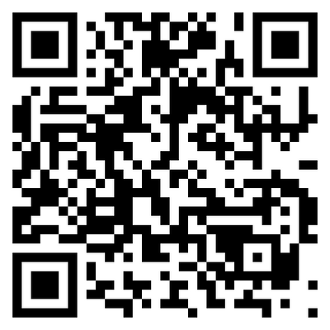
If you’d like to support T3WM in sharing the Good News of Jesus with more people, you can give by scanning the QR code below or by visiting the link here:
https://www.t3wm.org/donate-to-t3-global

